Slide 1
OS 2021
Homework 2: Simple Key-value Store
(Due day 2021/11/29 23:59:59)
Github Classroom
TA : 李昀澤
E-mail : p76091292@gs.ncku.edu.tw

Slide 2
Objective and Background

Slide 3
Objectives
Simple network (socket) programming & multithreaded programming in Linux
Implement a concurrent client-server based database system
Using the Socket interface and the POSIX thread
Learning and Tackling some Multithreading Programming Issues
race condition
thread safety & reentrancy

Slide 4

Background: Client-Server Model
Server machine
owns and manage some resources
runs server processes to accept requests from the client machines processes
Client machine
Runs client processes making requests to use the resources on the server machine
1. The client makes a request
2. Server handles the request
Client
Process
Server
Process
3. The server makes a respond
Resource

Slide 5
Background: Database Server
Key value store is an implementation of NoSQL database
In contrast to SQL database (refer to SQL v.s NoSQL database)
Data is stored as key value pairs
A value is associated with it’s key when stored to the database
e.g., (key<string>=“OSLAB”, value<string>=“520”) can be a key value pair data
A value is retrieved from the database using it’s key
Client
Process
Client
Process 2
2. Get (“OSLAB”)
1. Put (“OSLAB”, “520”)
3. Retrieve “520”
Server
Process

Slide 6
Programming Libraries (Brief Introduction to the Socket Interface and the pthread Library)

Slide 7
Network Programming Interface: Socket Interface
Socket interface
A set of functions for network programming in Linux
<sys/socket.h>
Functions
Socket manipulations
Socket(): create a socket, return a file descriptor
Bind(): bind an file descriptor with an address
Listen()
Connect()
Accept()
Communications
Send()/Receive()
You can refer to the Linux manual page for details
e.g., page of the socket function call
User process
User code
Socket interface
(UNIX I/O)
TCP/IP
Kernel code
Hardware interface
Network
Adaptor

Slide 8
Brief Workflow of the Socket Interface
Client program
Server program
A function call
getaddrinfo
getaddrinfo
socket
socket
bind
We can’t build another connection until the previous one is closed
listen
Connection request
connect
accept
Wait for another
Connection request
Doing some bidirectional read(), write() …
close
read
close
End of file (EOF)

Slide 9
Why Multithreading?
Serving multiple network clients (e.g., this assignment)
A thread per client, so a client request don’t block the server
Rapidly interact with humans
e.g., graphic user interface (GUI)
For parallelism computing
Most modern machines have multi-core processors
The OS kernel can schedule different threads on different core

Slide 10
POSIX thread
Also known as pthread
A standard interface for manipulating threads from C programs
<pthread.h>
Functions
Thread creation
pthread_create
Thread synchronization/termination
pthread_mutex_lock
pthread_join
`$ man pthread` for detailed information

Slide 11
pthread: Creation of Threads
A main thread that start the main function can create other threads
pthread_create
Threads share the virtual address space
pthread_self to know which thread context is currently running
convenient, but we MUST handle some data sharing issues! (mentioned later)
_libc_start_main()
Virtual Address Space of the process
main()
pthread_create(thread_routine)
code
void *thread_routine(void * argv)
{
printf(“Hello World!\n”);
}
data
pthread_create(thread_routine)

Slide 12
pthread: Termination of Threads
A thread terminates implicitly as it returns
For explicit terminations
pthread_exit
Note that it is different from exit, which terminate the whole process
pthread_cancel: can be used by a thread to kill another thread
If the main thread call this, it waits for other threads to terminate and finally terminate itself

Slide 13
pthread: Reaping Terminating Threads
pthread_join “reap” the result from a thread, the caller blocks until a dedicated thread terminates
All threads are created as joinable by default, and the memory resources (e.g., stack) are not freed until it is joined by another thread
In this sight, memory leaks happen when a thread is not properly joined
Memory leaks are particularly serious for programs like daemons and servers, which barely terminate
Virtual Address Space of the process
code
pthread_create(thread_routine)
thread 1
block
data
thread 2
pthread_join(thread 2)
(thread 1 blocks until thread 2 terminates)

Slide 14
pthread: Detaching Threads
All threads are created as joinable by default (in the previous slide)
A thread can become detached by others or itself using pthread_detach
Can NOT be reaped or killed by others
Memory resources are freed automatically when the thread terminates
Virtual Address Space of the process
thread 1
code
pthread_detach()
data
thread 2
(free it’s resource when it terminates)

Slide 15
Multi-threading Programming Issues (Introduction to Race Condition and the Solutions)

Slide 16
Issue of Multithreading: Race Condition
Race condition when the correctness of a program depends on dedicated execution flow of threads (specifically, execution order of the instructions)
Usually due to the programmer does not aware the fact that a multithreaded program should work correctly for any of the feasible execution flow of threads
e.g., A programmer assumes that thread A will reach line 10 before thread B does
Factors
OS task scheduler
Compiler
Hardware
…

Slide 17
Race Condition Example: Read/Write to a Shared Variable
Example: There are two threads executing the for loop. The programmer expects that cnt should become 10
Try run `race.c` under your assignment directory yourself and inspect the result
Code
Thread 1’ s context
Thread 2’s context
Context switch
// shared variable cnt
volatile long cnt = 0;
for (int i = 0; i < 5; ++i) {
cnt++;
i = 0, read cnt, get 0
i = 0, read cnt, get 0
i = 0, write 1 to cnt (cnt = 1)
i++
i = 0, write 1 to cnt (cnt = 1)
i++
Time

Slide 18
Race Condition Example: Read/Write to a Shared Hash Table
Hash table
KV pair
KV pair
KV pair
KV pair
hash_func(k)
KV pair
KV pair
KV pair
KV pair
KV pair

Slide 19
Race Condition Example: Read/Write to a Shared Hash Table
Hash table
KV pair 3
Thread1:
Insert KV pair 3 after KV pair1
KV pair1
KV pair2
tmp_ptr

Slide 20
Race Condition Example: Read/Write to a Shared Hash Table
Context switch to thread 2
Context switch to thread 1
Hash table
Thread1:
Delete KV pair 1
KV pair1
KV pair2
KV pair3
tmp_ptr of thread 1
Thread2:
Insert KV pair 3 after KV pair1
Reference

Slide 21
Solution: Properly Handle Critical Sections
Critical section code sections in the program that access to shared resources, which may result in a race condition if not properly tackled
Programmers can’t really control the thread scheduling, but we can use some high level approaches to handle the critical sections
mutex_lock
pthread_mutex_lock
semaphore
<semaphore.h>

Slide 22
Solution: Properly Handle Critical Sections
Example: Using a semaphore to implement a mutex to “lock” the critical section
Code
Thread 1’ s context
Thread 2’s context
volatile long cnt = 0;
sem_t mutex;
for (int i = 0; i < 5; ++i) {
+ lock(mutex);
cnt++;
+ unlock(mutex);
}
Try to get the lock, success
i = 0, read cnt, get 0
Try to get the lock, fail and wait
i = 0, write 1 to cnt (cnt = 1)
Release the lock
i++
i = 0, read cnt, get 1
i = 0, write 1 to cnt (cnt = 2)
Time
i++

Slide 23
Be Careful when Manipulating Threads!
What’s the problems?
main function
Thread routine
Int main (int argc, char **argv)
{
int connfd;
…
while (1) {
/* main thread blocks on accept function to wait for connections */
connfd = accept(listenfd, …);
pthread_create(&tid, NULL, thread_routine, &connfd);
}
}
void *thread_routine (void *argv)
{
int connfd = *((int*)argv);
…
}

Slide 24
Be Careful when Manipulating Threads!
What’s the problems?
main function
Thread routine
Int main (int argc, char **argv)
{
- int connfd;
+ int *connfd;
…
while (1) {
/* main thread blocks on accept function to wait for connections */
+ connfd = malloc(sizeof(int));
+ *connfd = accept(listenfd, …);
pthread_create(&tid, NULL, thread_routine, &connfd);
+ pthread_create(&tid, NULL, thread_routine, connfd);
}
}
void *thread_routine (void *argv)
{
int connfd = *((int*)argv);
+ pthread_detach(pthread_self());
…
}

Slide 25
Thread Safety vs. Reentrancy
Both are properties of functions
Thread safety functions
Functions that always produce correct results under a multithreaded environment
Reentrancy functions
Functions that don’t keep “states” across multiple invocations
Many functions in C libraries have two versions
Normal version
e.g., strtok
Reentrance version: the ones with “_r” suffix
e.g., strtok_r

Slide 26
Common Multithreading Programming Models

Slide 27

Multithreading Design Pattern Example (1): Thread-per-Message Model
The server program create a new thread for each request and delete the thread while the request is done
Server program main thread
(responsible for accepting requests)
Client programs

Slide 28
Multithreading Design Pattern Example (2): Worker Thread Model (Thread Pool)
Thread-Per-Message model may bring high thread creation/destruction cost
In a thread pool model, we create a pool of threads in advance
…
…
Server program main thread
(responsible for accepting requests)
Work queue
Worker threads
(Thread pool)

Slide 29
Requirements (Important!) (Your Implementation should fulfil the requirements in the following slides!)

Slide 30
Assignment Requirement: Client-server Model
We are going to build 2 programs: a server program and a client program
They should meet the following requirements respectively
Your server process can concurrently service multiple clients and handle race conditions
Your client program should provide a simple command line based interface, where the
user can make following three commands to communicate with the server process
SET [KEY] [VALUE]
GET [KEY]
DELETE [KEY]
-> See next slide for the details!

Slide 31
Assignment Requirement: Command Format and Return Values
Command format and return values (important! MUST follow this pattern)
SET [KEY] [VALUE]
If [KEY] already exists, hint an error
Otherwise, insert the key value pair and hint a success
GET [KEY]
If [KEY] exists, return and print out it’s value
Otherwise, hint an error
DELETE [KEY]
If [KEY] does not exist, hint an error
Otherwise, delete it from the database and hint a success
[KEY], [VALUE] are stored as strings (e.g., char * in C)
No length limit, so you must dynamically allocate the memory space
Also hint an error if the command does not follow above format, i.e., unknown commands

Slide 32
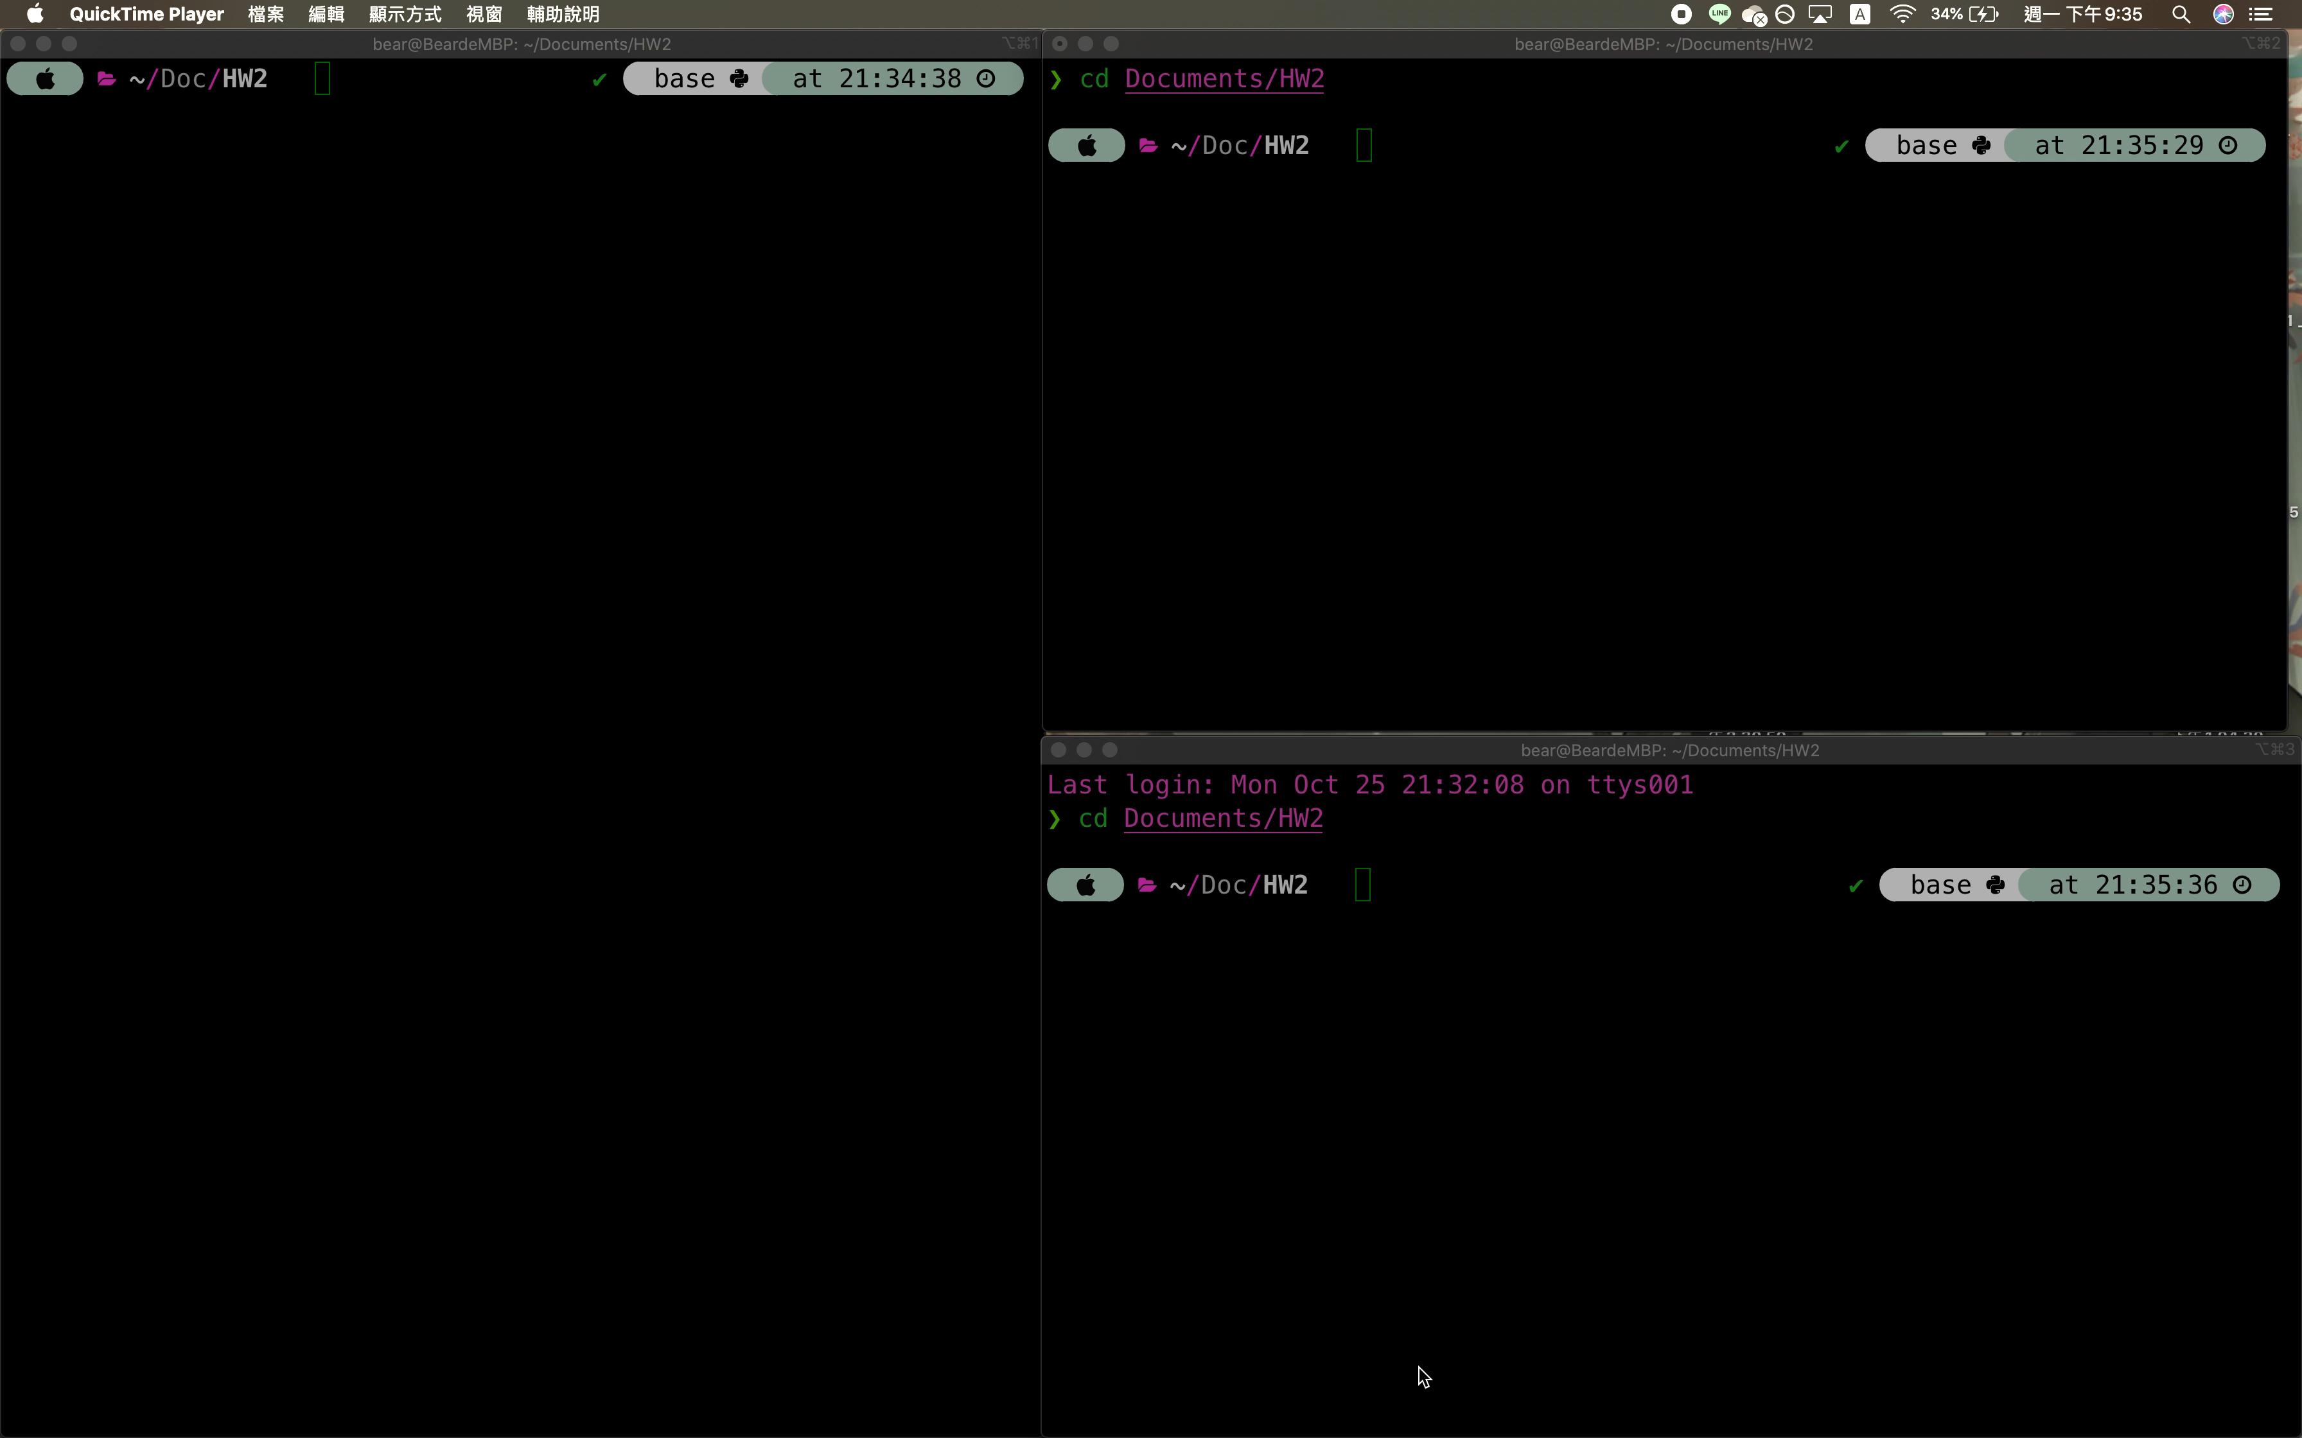
Demo Video
Your assignment is demo in the way shown in the video
Client process 1
Server process
Client process 2

Slide 33
Assignment Requirement: Assignment Files
Besides the ELF, we will also ask you to explain your source code implementation. In summary, you should place the following 4 files in your GitHub repository!
Source code files (which we will provided templates for you to complete them)
/server/server.c
/client/client.c
ELF files (Which you build them yourself and run them during the demo)
/build/server
/build/client

Slide 34
Assignment Requirement: Constraints
Constraints (Important!)
Must program in C
Must use <sys/socket.h>, <pthread.h>
Do NOT use fork() to create child processes
No other constraints! As long as your three commands work fine, feel free to implement your own
data structure
multithreading model

Slide 35
About the Given Template Code
The program parameters are as following
Host program: `./build/server –p [port number]`
Client program: `./build/client –h [host name] –p [port number]`
For the hostname, you can simply just pass “localhost”
We also supplied some socket helper functions in `common/sock.h`
Some helper functions for you to build the socket connections easily
Open_listenfd
Open_clientfd
You can choose whether or not to use them

Slide 36
Helper Functions in sock.h
Client
Server
A Library call
getaddrinfo
getaddrinfo
socket
socket
open_listenfd
open_clientfd
bind
listen
Connection request
Wait for another
Connection request
connect
accept
Doing some bidirectional read(), write() …
close
read
close
End of file (EOF)

Slide 37
Assignment Repository & About the Score
GitHub Classroom
Your code is scored based on
The server program is able to concurrently accept multiple clients (40%)
Correctness of the three APIs (20% for each)

